Slide 1
Library Module
University Management system

Slide 2
Group Members
ANUSHA SAAD 19K-0281
SAMAN KHAN 19K-0354
HERMAIN QADIR 19K-1517

Slide 3
LIBRARY MODULE
The software helps admin/Librarian manage author details and book inventory details (add, update, delete)
Librarian is also responsible for issuing book to a student.
Students can view which books are available and in stock from the comfort of their homes

Slide 4
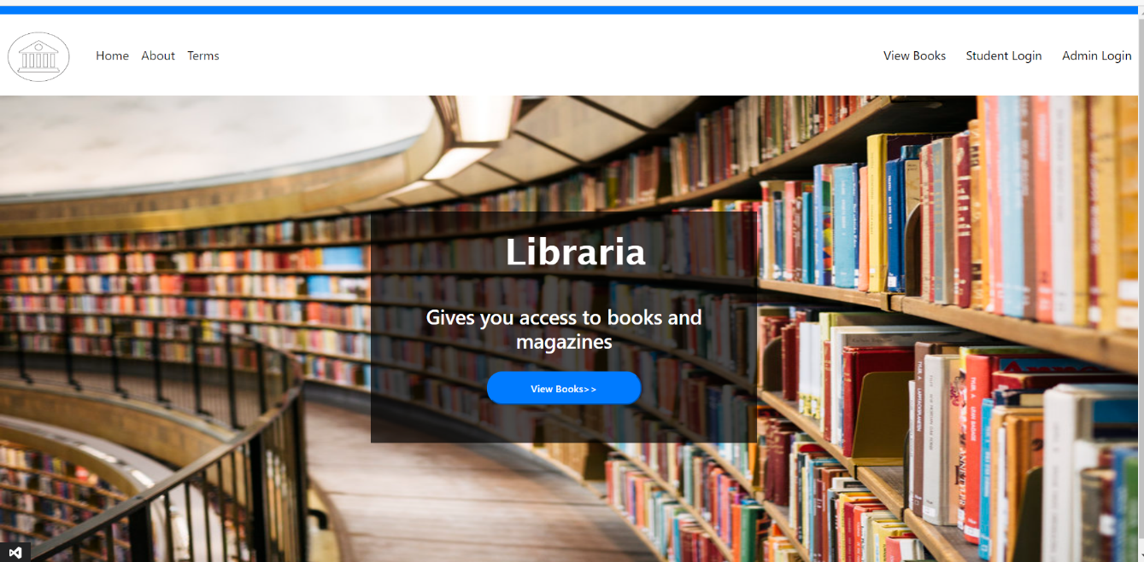
HOMEPAGE

Slide 5
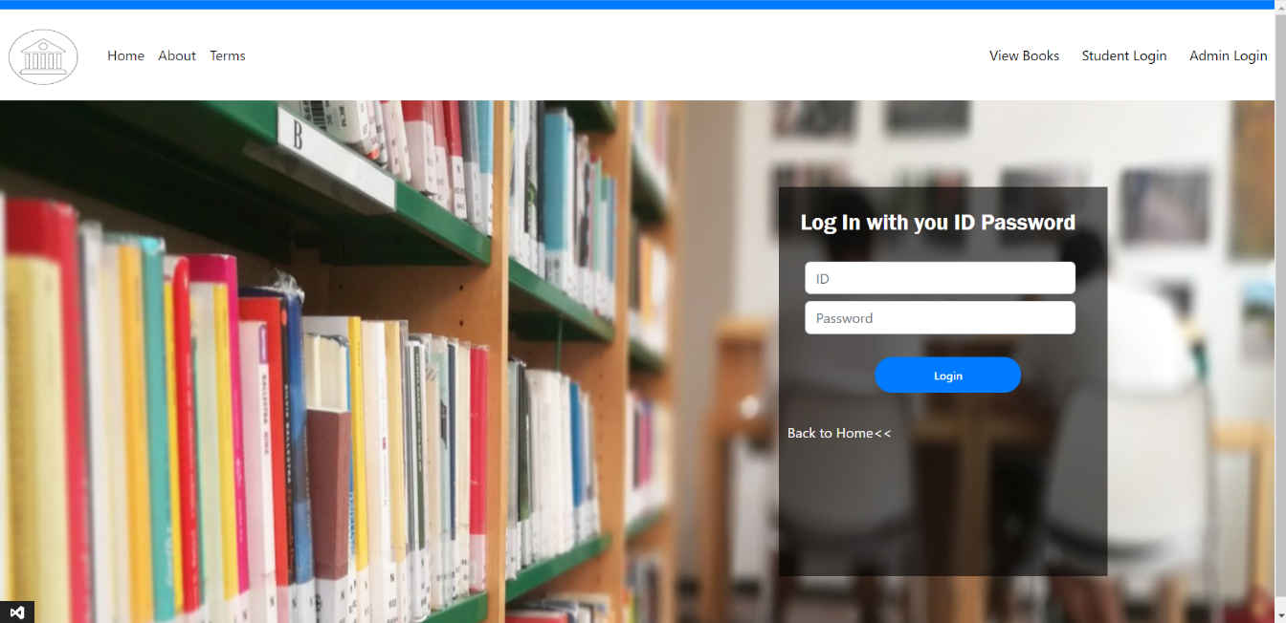
Login PAGE

Slide 6
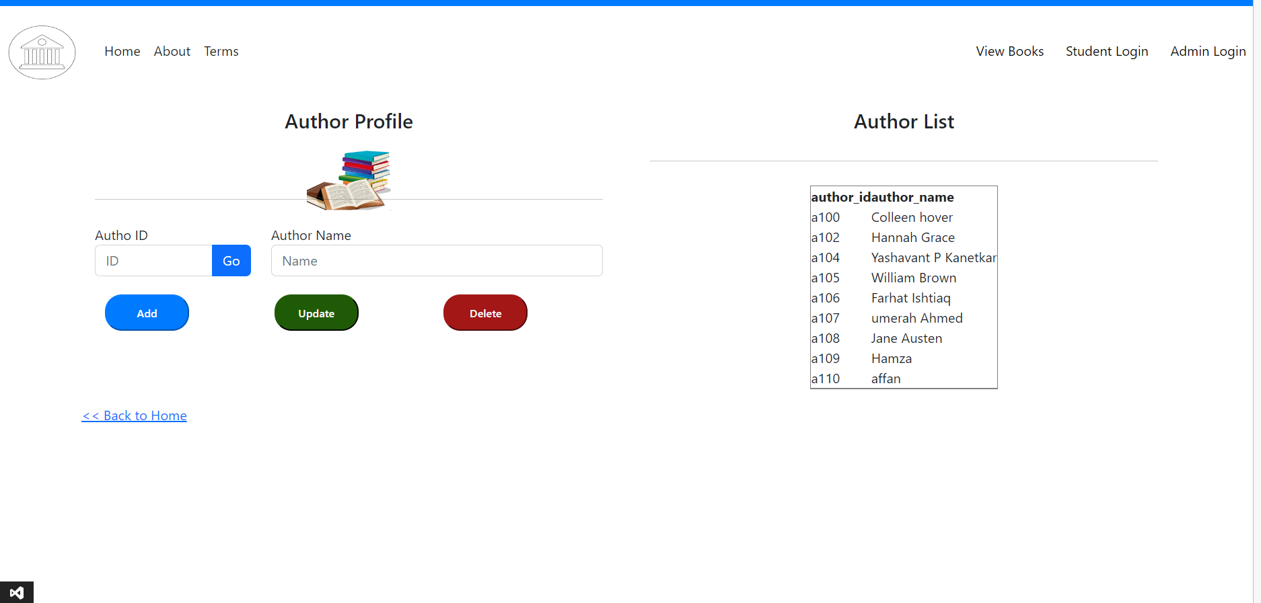
Author Manage-admin

Slide 7
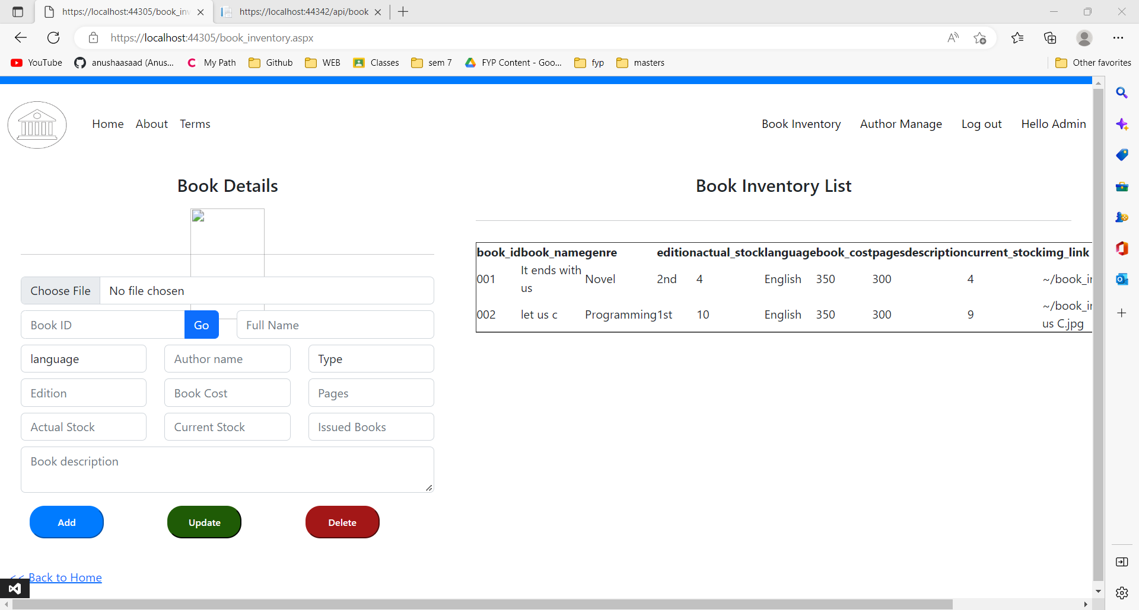
BOOK INVENTORY

Slide 8
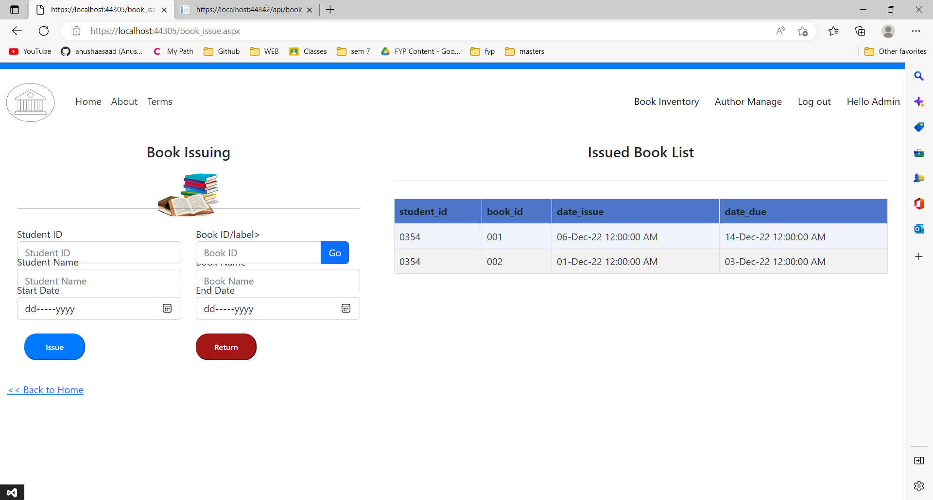
Book issue

Slide 9
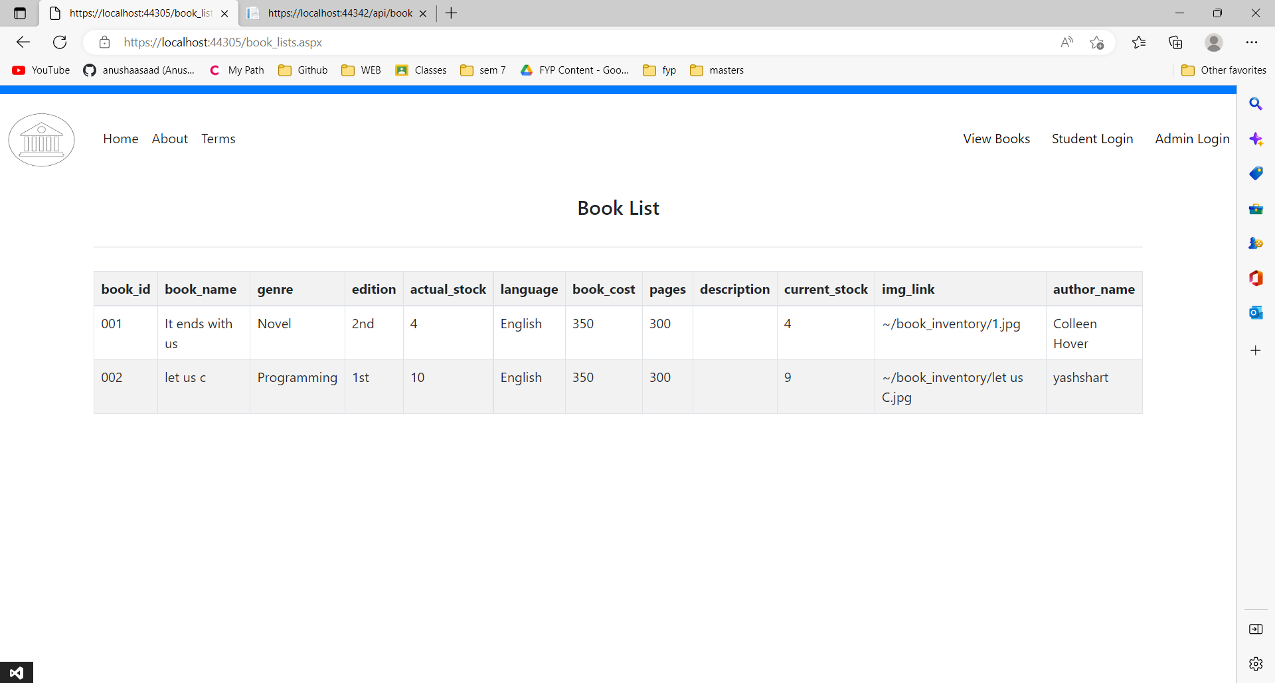
STUDENT PORTAL

